Slide 1

INFOSYS SPRINGBOARD VIRTUAL INTERNSHIP 6.0 TEAM C
SAVULA SNEHITHA

Slide 2
RECEIPT AND INVOICE DIGITIZER
A web application that allows users to upload receipts and invoices (PDF/Image/Scanned) and convert them into structured digital data for storage and analysis.
What This Project Does
The Receipt & Invoice Digitizer is a web-based application that allows users to:
Register and log in securely
Upload receipts or invoices (PDF, image, scanned copy)
Store the uploaded files in the system
Maintain digital records securely
The system converts physical or scanned receipts into digitally manageable data and stores them in a database for future access.

Slide 3
PROBLEM STATEMENT
Problem It Solves
Manual receipt handling causes:
Data loss
Errors in entry
Difficulty in tracking expenses
This system:
Centralizes receipt storage
Secures user authentication
Enables structured digital record keeping

Slide 4
MY CONTRIBUTION
Frontend Contribution
Designed login and registration pages using HTML and CSS
Created responsive dashboard UI
Implemented file upload interface
Connected frontend forms to backend APIs

Slide 5
WORKING
Frontend is responsible for:
Taking user input
Validating input
Sending data to backend APIs
Handling backend responses
Updating UI dynamically

Slide 6
STRUCTURE
Your frontend has 3 major pages:
Registration Page
Login Page
Dashboard Page
Each page is built using structured HTML.
Registration Form
HTML contains:
Input for Name
Input for Email
Input for Password
Preferred Language dropdown
Submit button

Slide 7
CSS
Styling Layer (CSS)
CSS handles:
Layout structure
Button design
Responsive alignment
Error message styling

Slide 8
Registration Flow (Step-by-Step)
The frontend collects user input through structured HTML forms, validates the input using JavaScript, and communicates with backend APIs using HTTP requests. After login, the received JWT token is stored in local storage and attached to future API requests for authentication. The dashboard allows secure file upload using multipart form data, and UI updates dynamically based on backend responses.

Slide 9
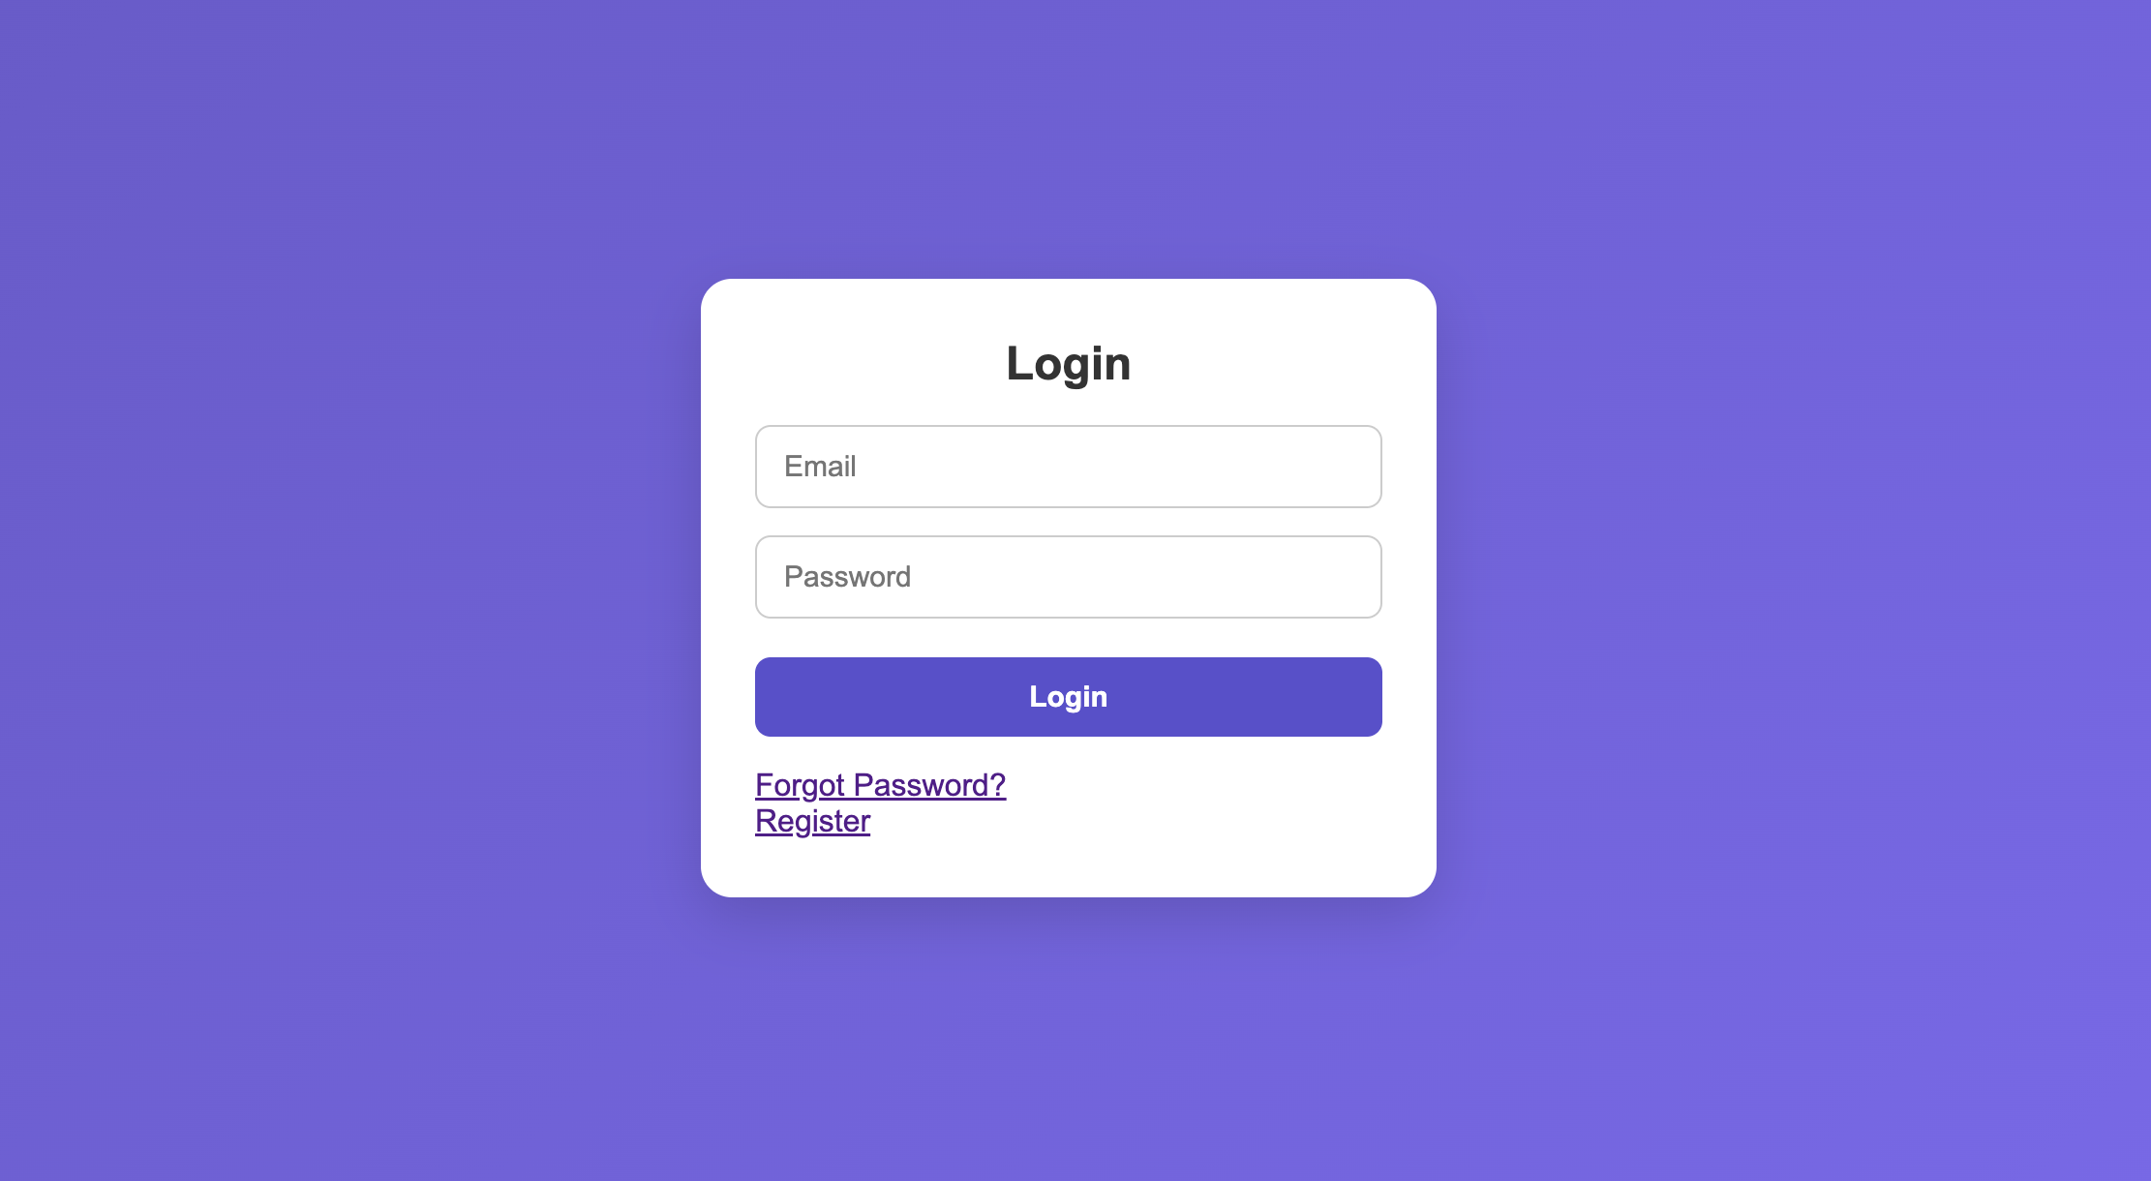
OUTPUT SCREENS

Slide 10
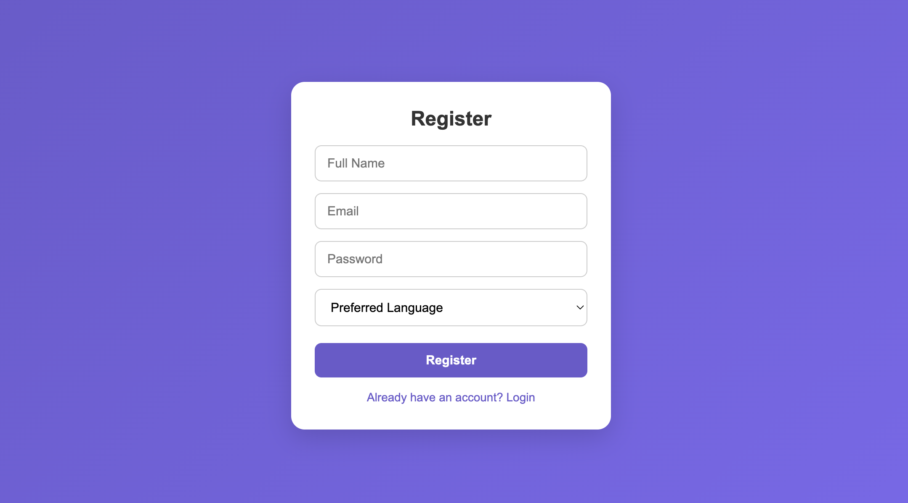
OUTPUT SCREENS

Slide 11
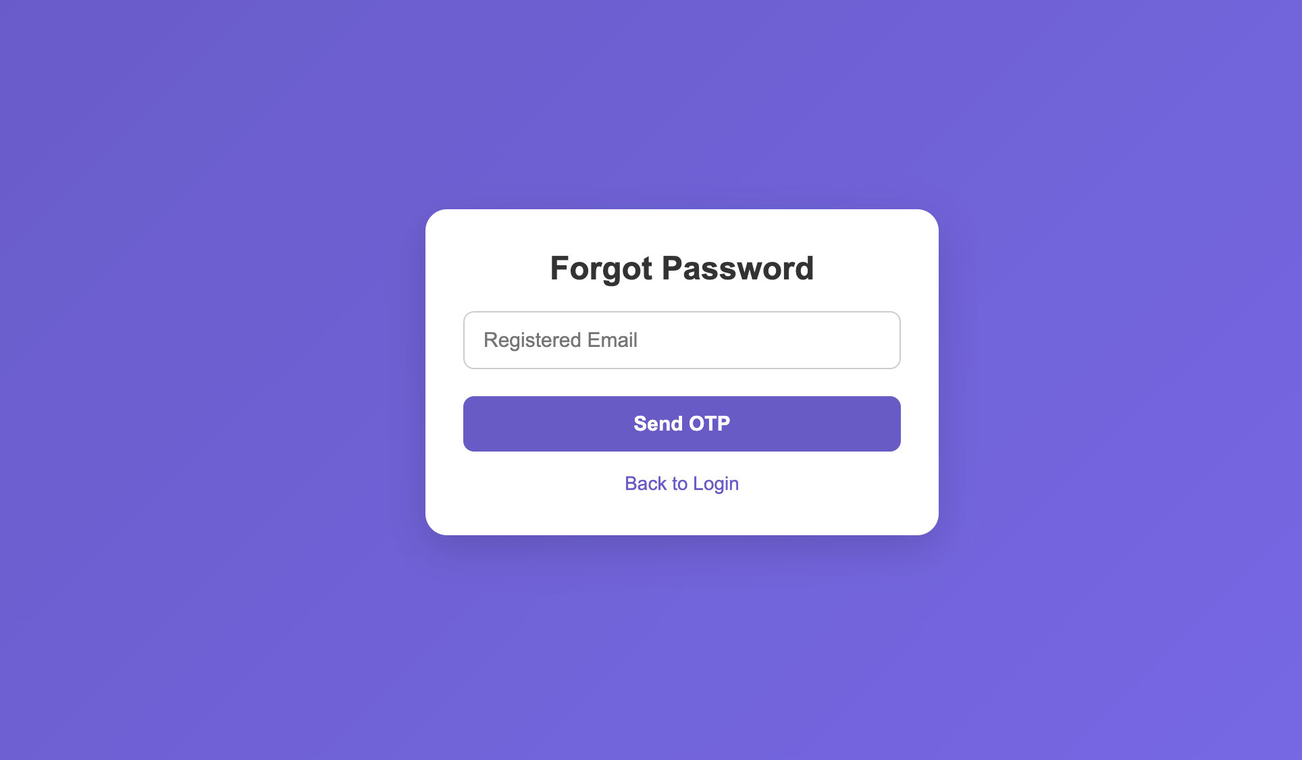
OUTPUT SCREENS

Slide 12
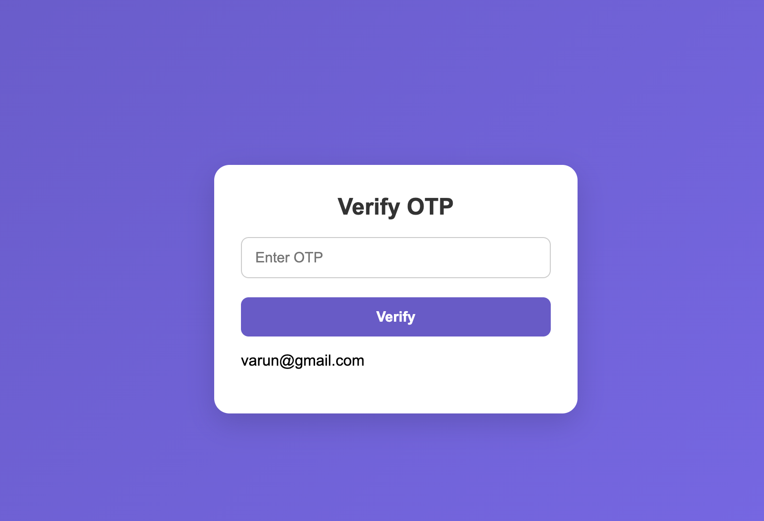
OUTPUT SCREENS

Slide 13
THANK YOU
SAVULA SNEHITHA

